Slide 1
BU Sustainability: Understanding How Weather Impacts Waste
Team 2
Zeqi Wang, Timur Zhunussov, Baicheng Fang, Akshad Ramnath
Notes:
Hi everyone! Today, we are here to present the final presentation about our Research on BU Sustainability, looking for some patterns about how the relationship between weather and waste generation will be.

Slide 2



Project Introduction & Motivation
Support BU Sustainability
Find a correlation between weather and waste generation at BU
Using Data provided by Casella and Contelligent
Notes:
The aim of this project is to support BU's Sustainability department in their efforts to transform the university's planning, operations, and culture towards a sustainable and equitable future. Specifically, the project seeks to investigate the correlation between weather conditions and waste production and storage. To accomplish this, we will analyze detailed data sets from various sources, including monitors, overall data, temperature data, and waste generation spreadsheets from Casella.
Our analysis of these datasets will provide valuable insights to BU Sustainability, enabling them to identify potential areas for waste storage improvement in the event of adverse weather conditions. Through a comprehensive analysis of the data provided by both the Sustainability Department and third-party vendors, the project aims to deepen our understanding of how external factors impact the waste collection process.

Slide 3

Goal of the project
The goal of this project is to see how BU sustainability can potentially improve waste storage location in the case of adverse weather conditions.
Notes:
Our ultimate goal is to offer insights that will help to enhance the waste collection process and support BU's sustainability objectives.

Slide 4
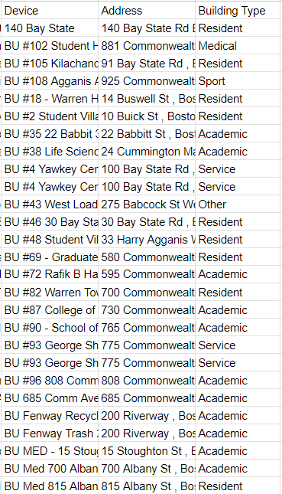
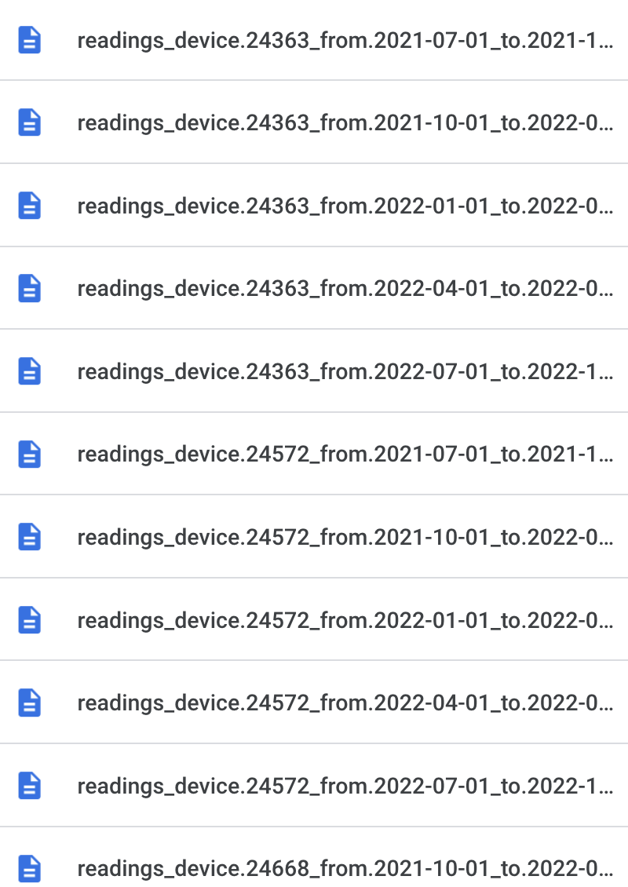
Topic: Relationship between Compressor PSI and Temperature - Zeqi Wang
(part of the data)
(Device Locations)
Notes:
Let’s begin by my research first
Intro
The research I focused on was finding out if there is a relationship between temperature and the compressor's psi value. The dataset I was using was the ‘readings_device.#####.csv’. The time frame of the data record was from 2021-07-01 to 2022-10-02, and 24 compressor machines were located at the BU campus (Charles, Fenway, and MED)

Slide 5
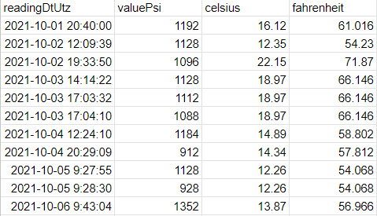
Topic: Relationship between Compressor PSI and Temperature - Zeqi Wang
(Sample Raw Data of Device 24363)
Notes:
Data Processing & Strategies
The initial data we obtained was very detailed in that it was recorded every few tens of seconds.

Slide 6
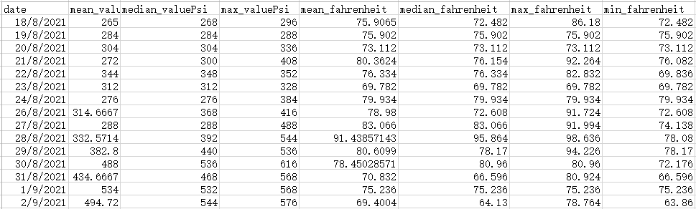
Topic: Relationship between Compressor PSI and Temperature - Zeqi Wang
(Processed data sample of Location 140 Bay State)
Notes:
To make the analysis more convenient, I calculated a summary of the data for each machine for each day, including the mean, median, minimum, and maximum values of PSI and temperature.

Slide 7
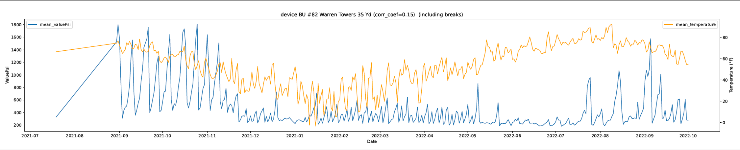
Topic: Relationship between Compressor PSI and Temperature - Zeqi Wang
(Whole dates line graph of
Average Temperature Fahrenheit (Yellow)
and Average Psi Value (Blue))
(For complete graphs, check here)
Notes:
For initial visualization, I plotted a line chart of temperature (Fahrenheit) with the Psi value for each machine, and here is an example of Warren Towers:This initial visualization didn’t provide too much information, to find out the relationship, my first strategy is to calculate the correlation coefficient*.

Slide 8
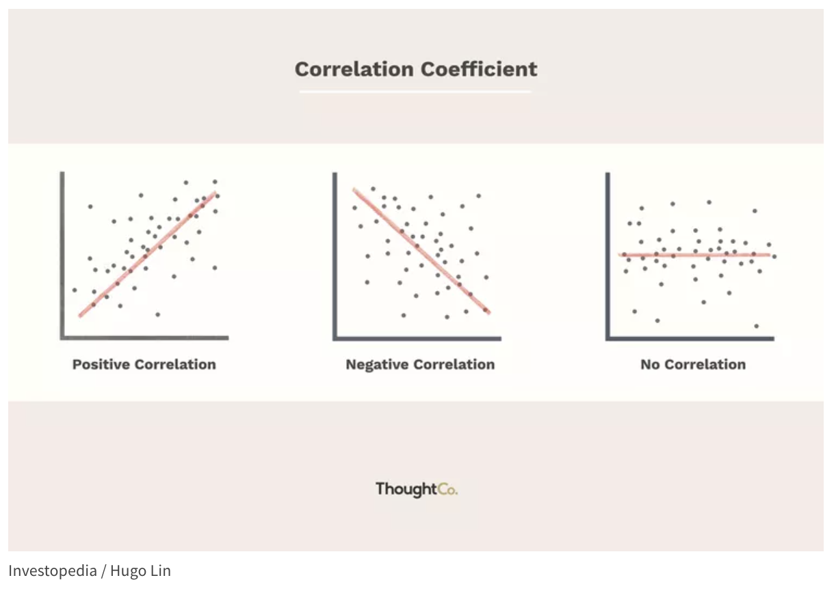
Background to understand the project - Correlation Coefficient
+1
-1
0
Notes:
To recap: * Correlation coefficient is a statistical measurement that describes the degree of relationship between two variables. (For example the psi value and temperature) and the coefficients are ranged from +1 to -1. If the correlation coefficient is positive, it means that there is a direct relationship between the two variables - as one increases, so does the other. If it is negative, it means that there is an inverse relationship - as one increases, the other decreases.

Slide 9
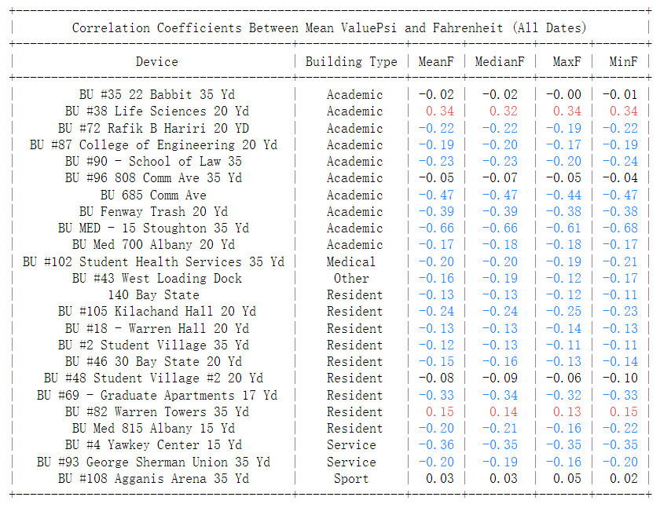
Topic: Relationship between Compressor PSI and Temperature - Zeqi Wang
Notes:
The table above shows the correlation coefficient of Mean ValuePsi and Fahrenheit for each location’s machine. The red color represents the positive relationship with coefficient above 0.1 and the blue color represents the negative relationship with coefficient below -0.1. There is no significant difference in different types of Fahrenheit values, and for further analysis, I will be using Mean Fahrenheit only.

Slide 10
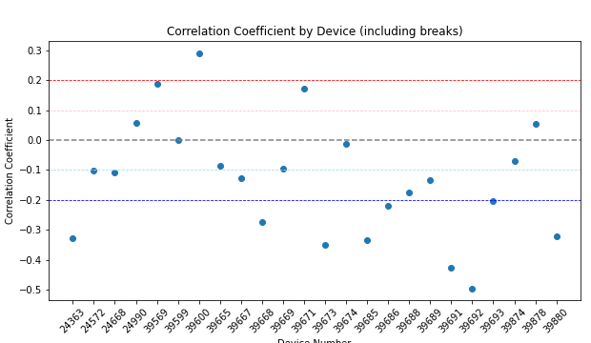
Topic: Relationship between Compressor PSI and Temperature - Zeqi Wang
Stronger positive relationship
Weaker positive relationship
Too weak to make reference
Weaker negative relationship
Stronger negative relationship
Device Number
(Assume the higher Psi Value, the more waste collected from the device)
Notes:
Here I borrowed the previous research graph for separating the level of relationship. This will be used as the strategy for the location map I will be showing later. The warm color represents positive relationship. And the cold color represents negative relationship.
And for better reference, I set weak and strong thresholds for them. Simply shown in the graph, Those beyond ± 0.1 is weaker relationship, and these beyond ± 0.2 is stronger relationship. They can also be distinguished by lighter and darker colors. And those devices within ±0.1 will not be considered since we can’t make conclusion for them.

Slide 11
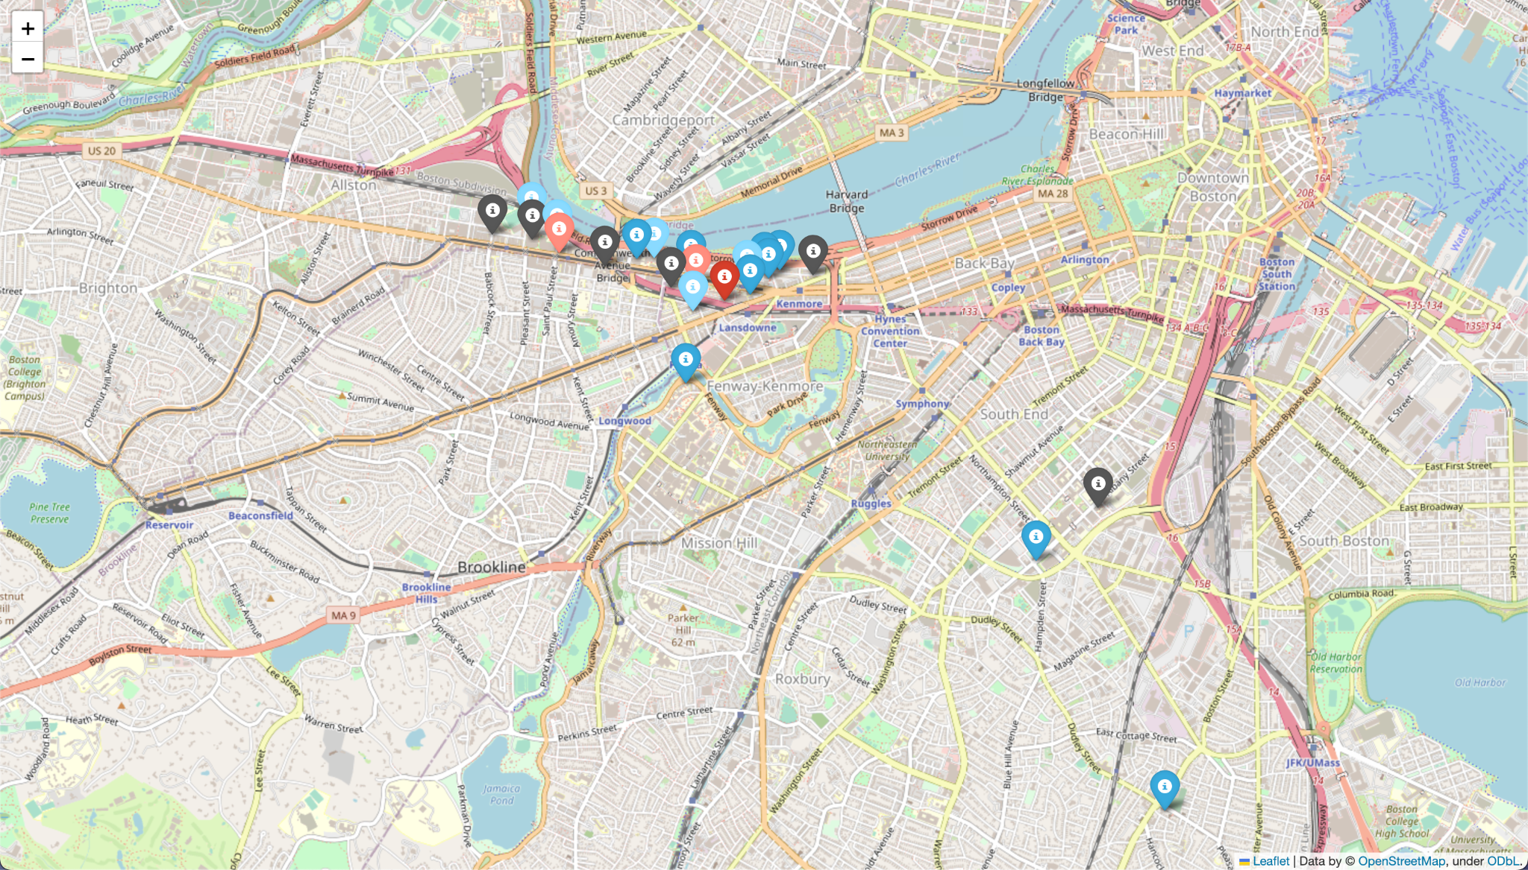




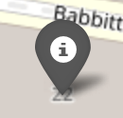
Topic: Relationship between Compressor PSI and Temperature - Zeqi Wang
Relationship Map (including breaks)
(click the map for more details)
Strong Positive
Weak Positive
Strong
Negative
Weak
Negative
Almost
No
Relation
Notes:
For visualization purposes, I plotted them on a map with colors based on their coefficient:
By looking at the data, we can see that most of the Academic and Residential buildings show some level of relationship between temperature and the psi value. Apart from Life Science and Warren Towers, which show a positive correlation, other residents and academic buildings are showing negative correlations. It means that in general, the colder the weather, the more wastes are being generated at the locations, assuming the higher the psi value, the more wastes are generated.

Slide 12
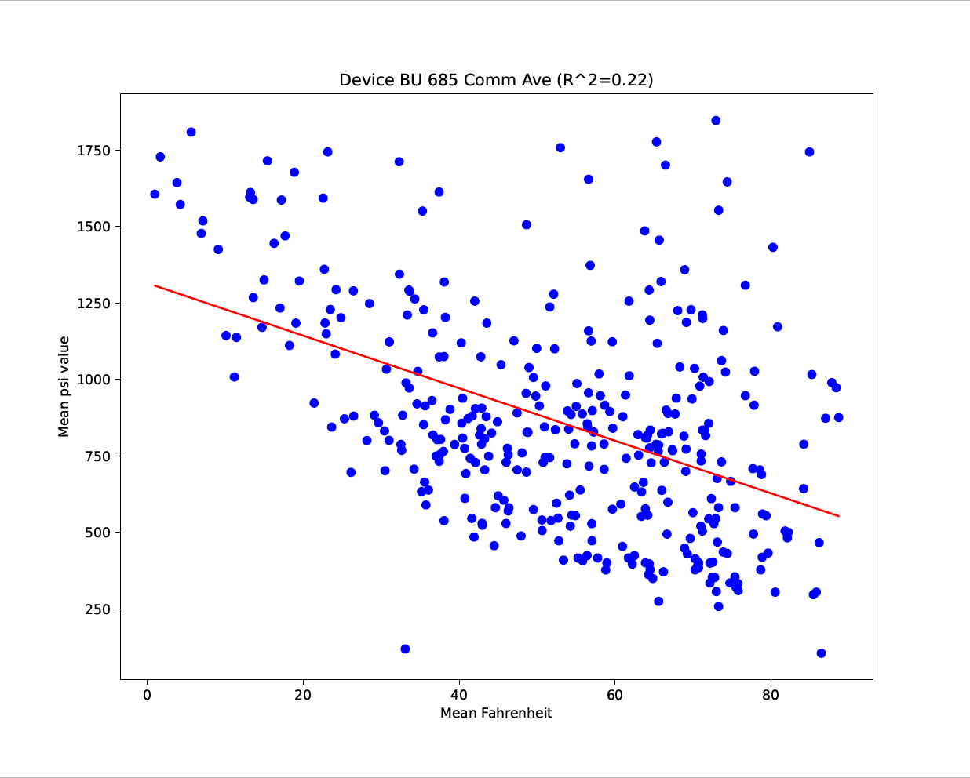
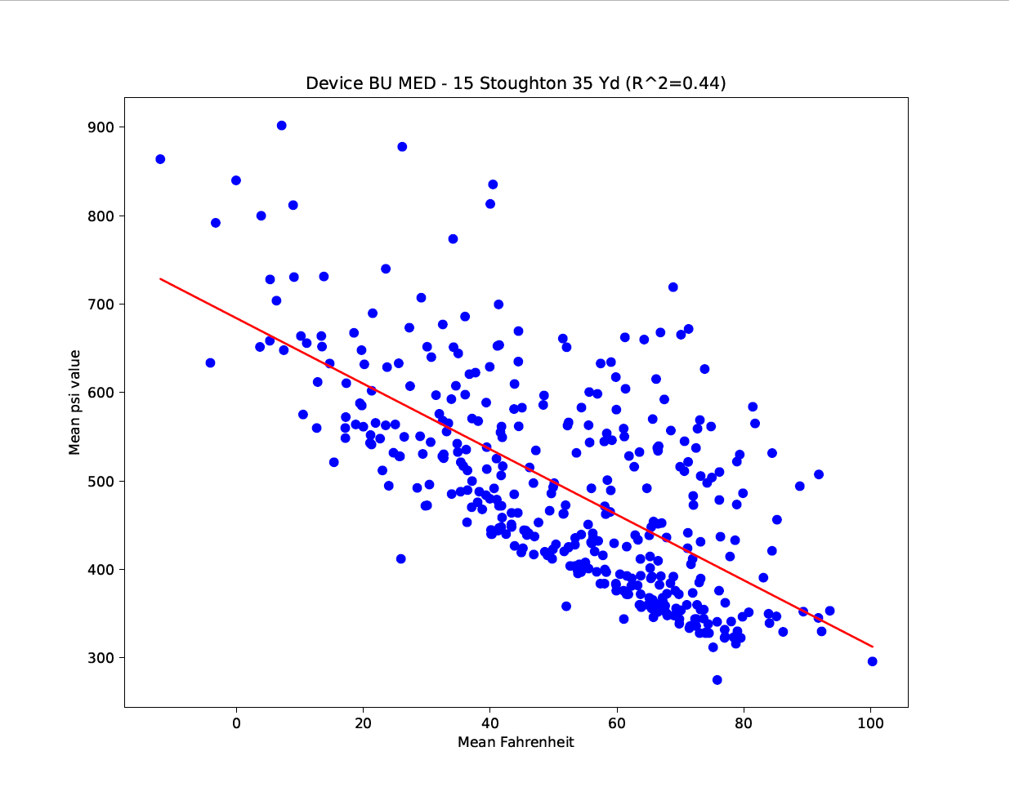
Topic: Further Analysis - Linear Regression - Zeqi Wang
(Linear Regression of location BU 685 Common Ave - Whole Dates)
(Linear Regression of location BU MED - 15 - Whole Dates)
(For complete graphs, check here)
Notes:
Linear regression provides more information than just the correlation coefficient. While the correlation coefficient measures the strength and direction of the linear relationship between two variables, linear regression can help predict the values of one variable based on the values of another variable (as shown in the red line in the graphs).
R-squared (R²) is a statistical measure in Linear Regression of how well the regression line fits the data. For the simplicity, R-squared values are ranged from 0 to 1, A value of 1 indicates a perfect fit, while a value of 0 indicates no relationship between the variables.
After using the linear regression, we are able to find out the relationship with higher reliability since there are more locations identified as ‘no obvious relationship’. The above two locations are the ones that show a strong correlation.

Slide 13
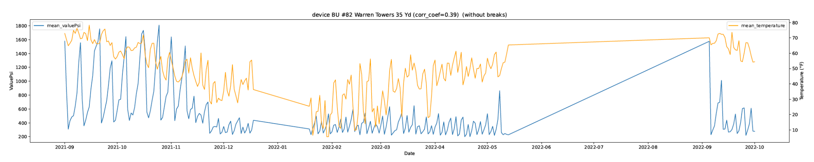
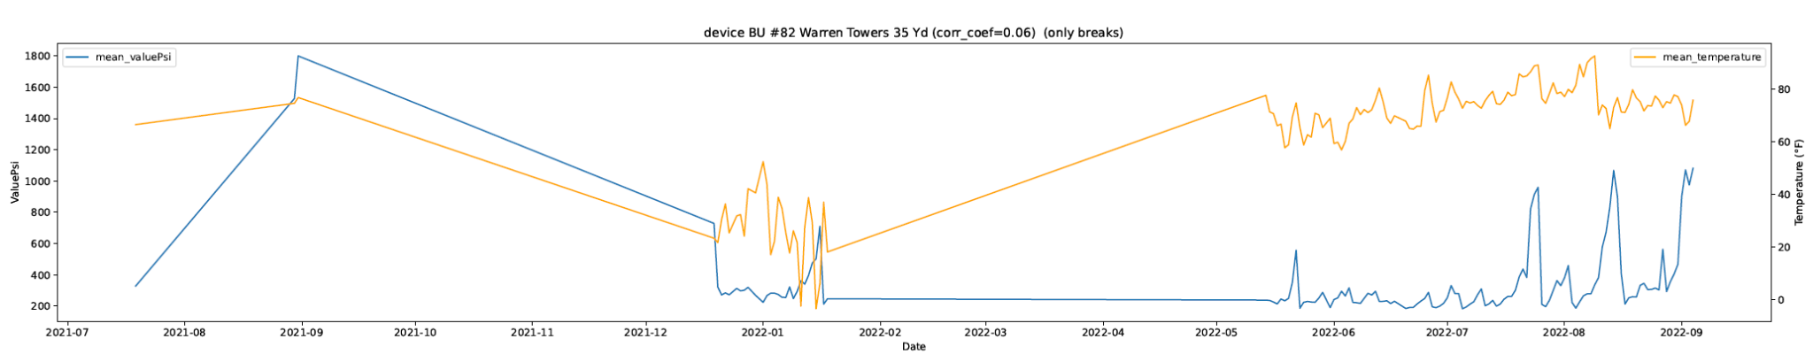
Topic: Extension idea - School Breaks - Zeqi Wang
Without breaks
VS
Only breaks
Notes:
During the research, I realized that temperature data alone may not be enough to accurately predict waste generation as there may be other factors at play, such as occupancy rates, types of buildings, etc. Our team tried to find out the population of each location but we didn’t have enough sources to look for that information. Therefore, one of the possible strategies is to analyze the data based on BU’s opening and closing dates, since there is a big population difference between school days and breaks.
The graphs above are the line chart of temperature versus Psi value at Warren Towers' data without breaks and only breaks.

Slide 14
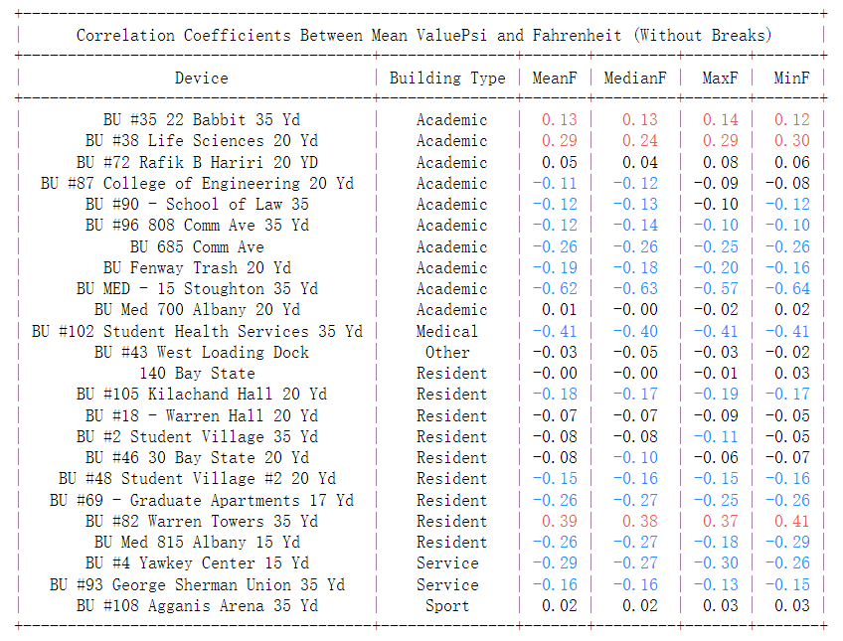
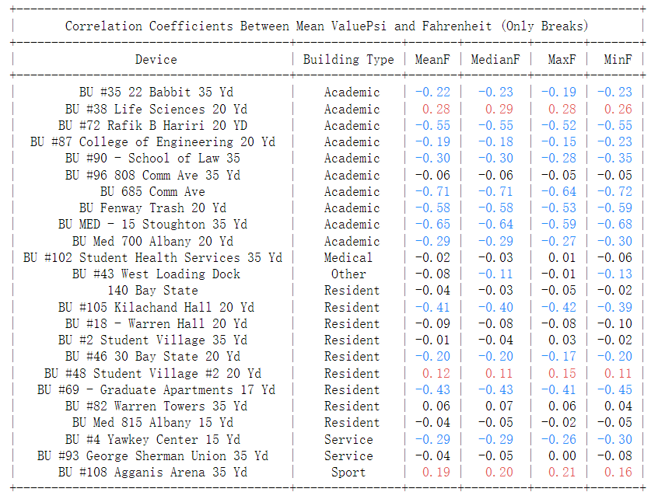
Topic: Extension idea - School Breaks - Zeqi Wang
Notes:
And here are the correlation coefficient table for these two data sets.
As we can see from the Table, after deleting the break dates from the original data, we are able to see there is one more Academic building (BU #35) showing a positive correlation while previously we only has BU #38 Life Science Building. And for Warren Towers, the original all-date data set only indicates a correlation of 0.15, and now we have 0.39. This means that the school break is also an important factor in affecting waste generation.
When we only look at the data during breaks, we can find out some resident buildings like BU #48 student village, and BU# 69 Graduate Apartments shows a higher relationship than during school days, and for Warren Towers, there is no relationship to be found. We can easily understand the reason by assuming students are leaving Warren Towers during breaks and the amount of waste generated is not large enough to have a correlation with the temperature.

Slide 15
Links to all Visuals - Zeqi Wang
For general References:
Correlation Map for all locations with all days
Correlation Map for all locations without breaks
Correlation Map for all locations with only breaks
More Reliable:
Linear Regression graphs for all locations with all days
Linear Regression graphs for all locations without breaks
Linear Regression graphs for all locations with only breaks
Notes:
There are also Maps and Linear Regression Graphs for these two datasets, to save the time, I provide the link above and you can check it out and making comparisons for yourselves after the presentation.

Slide 16
Conclusion - Zeqi Wang
Does temperature impact waste generation (in terms of Psi)?
The temperature may not be the reason or the cause for waste generation, but during the analysis, we can find out that temperature and waste generation do have some correlations.
Can we use temperature as a predictor of waste generation and service level requirements?
Based on dates (All dates, without breaks and only breaks)
Based on the location type (Academic, Residential, and others)
During School Opening Days: stronger relationships being found in Academic Areas
During School Breaks: relationships being found in Residential Areas.
Notes:
We can definitely use the temperature as a reference for predicting waste generation. However, this has to be done by cases, we need to consider whether we want to predict the waste generation during breaks or during school opening days. Once we decide which dates or how we want to predict, we need to focus on different locations. In general, we can find that during school opening days, there are stronger relationships being found in Academic Areas, and during school breaks, there are stronger relationships being found in Residential Areas. However, we cannot guarantee that we can make precise predictions on all locations. By looking at the higher absolute value of correlation coefficients and higher value of R-squared value of Linear Regression, we can make reliable predictions in locations like BU 685 Comm Ave, BU MED, and Warren Towers. For a complete prediction graph for all locations, please check the above Correlation Coefficient tables & Maps and Linear Regression Graphs.

Slide 17
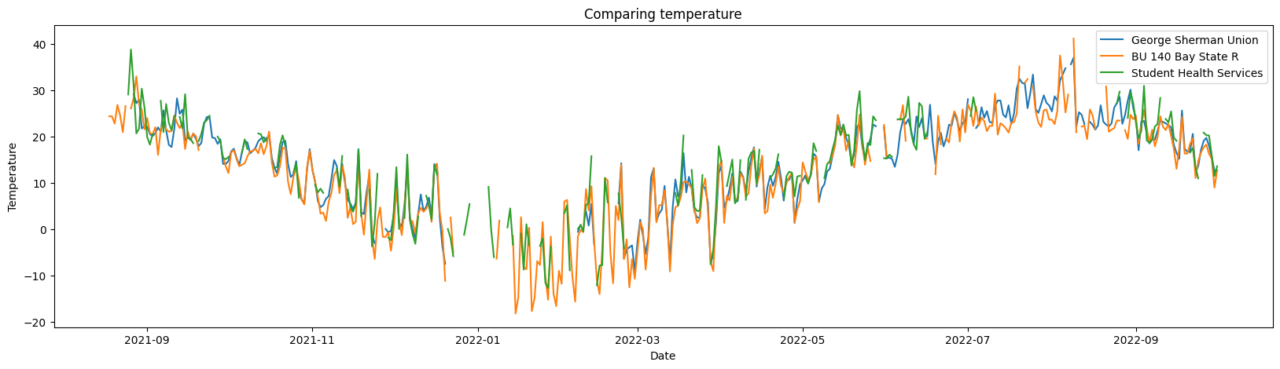
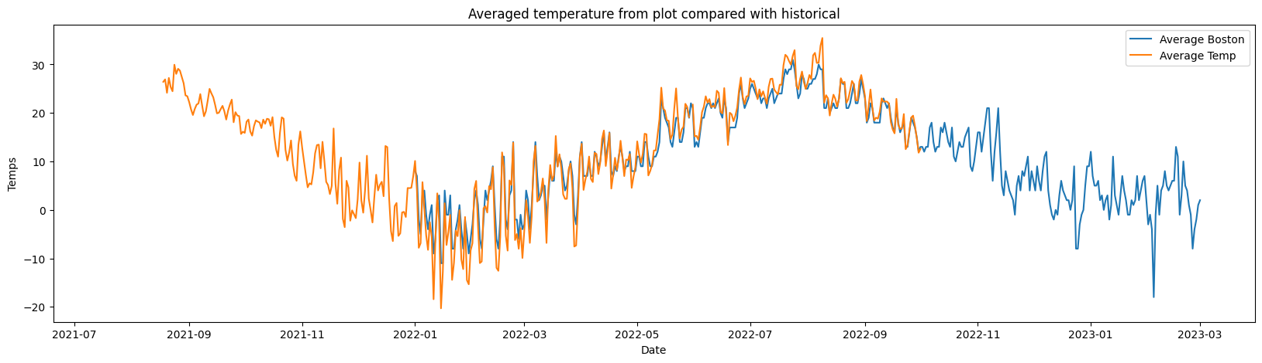
Assumptions and limitations
Temperature from different devices are close within slight margin
Averaged daily temperature from data compared with data from National Centers for Environmental Information Climate Data Online

Slide 18
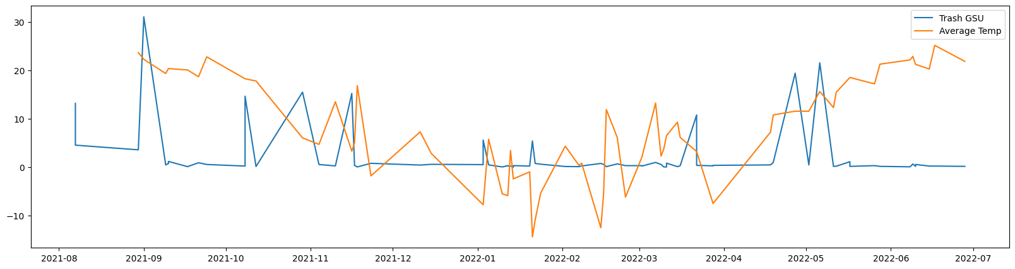
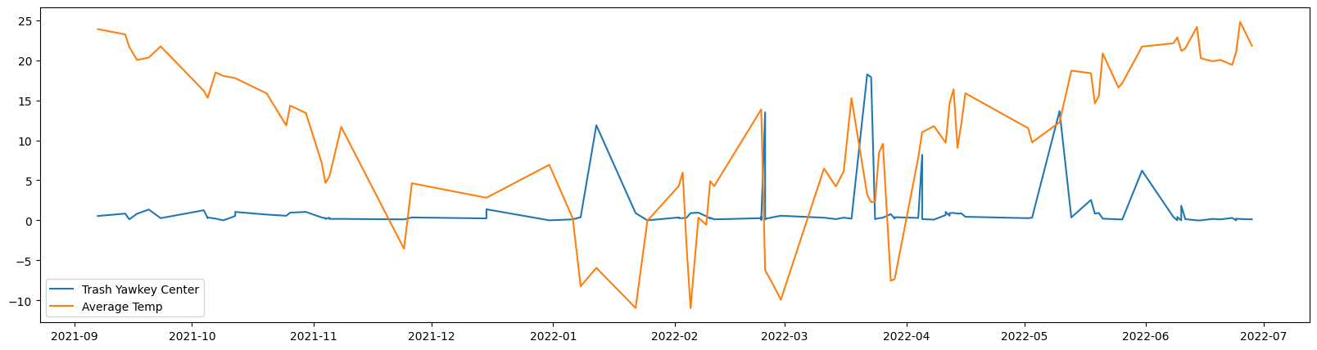
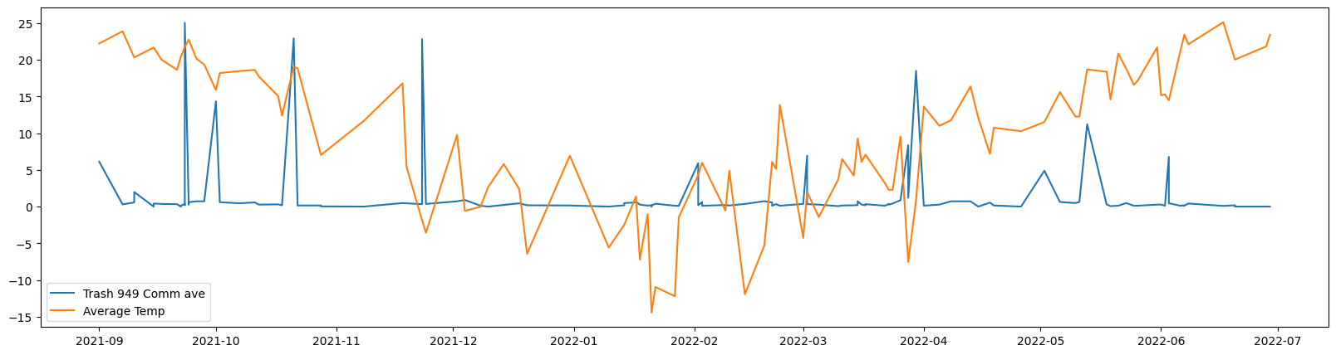
Preliminary analysis of most grossing locations
Correlation coefficient: 0.11893668357161091
According to our findings there is very weak correlation between the average daily weather and the weight of produced trash
Correlation coefficient: -0.17200522527145373
Correlation coefficient: 0.03485458343604092

Slide 19
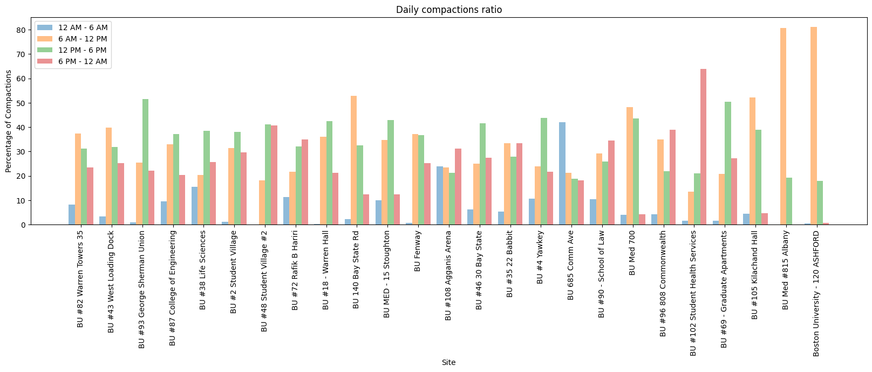
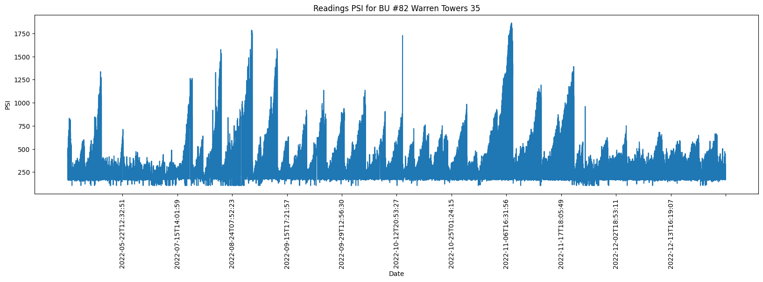
Distinguishing between compactions and waste pickups
Locations with most compactions
The goal of identifying any patterns regarding the frequency of pickups at certain locations and times. I began by examining compactions at different locations:
Warrant towers PSI reading

Slide 20
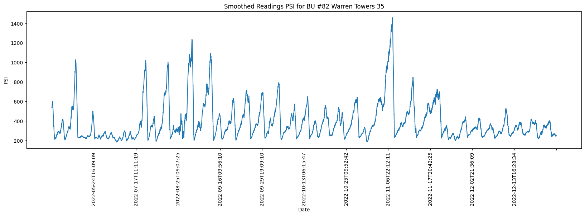
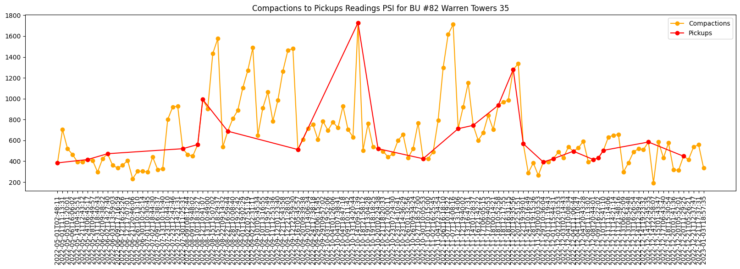
Distinguishing between compactions and waste pickups
Results of smoothing function over 50 neighboring data points to cleanup the data
The results of separation of compactions with PSI values around 30 - compactions
PSI values above 200 - pickups

Slide 21
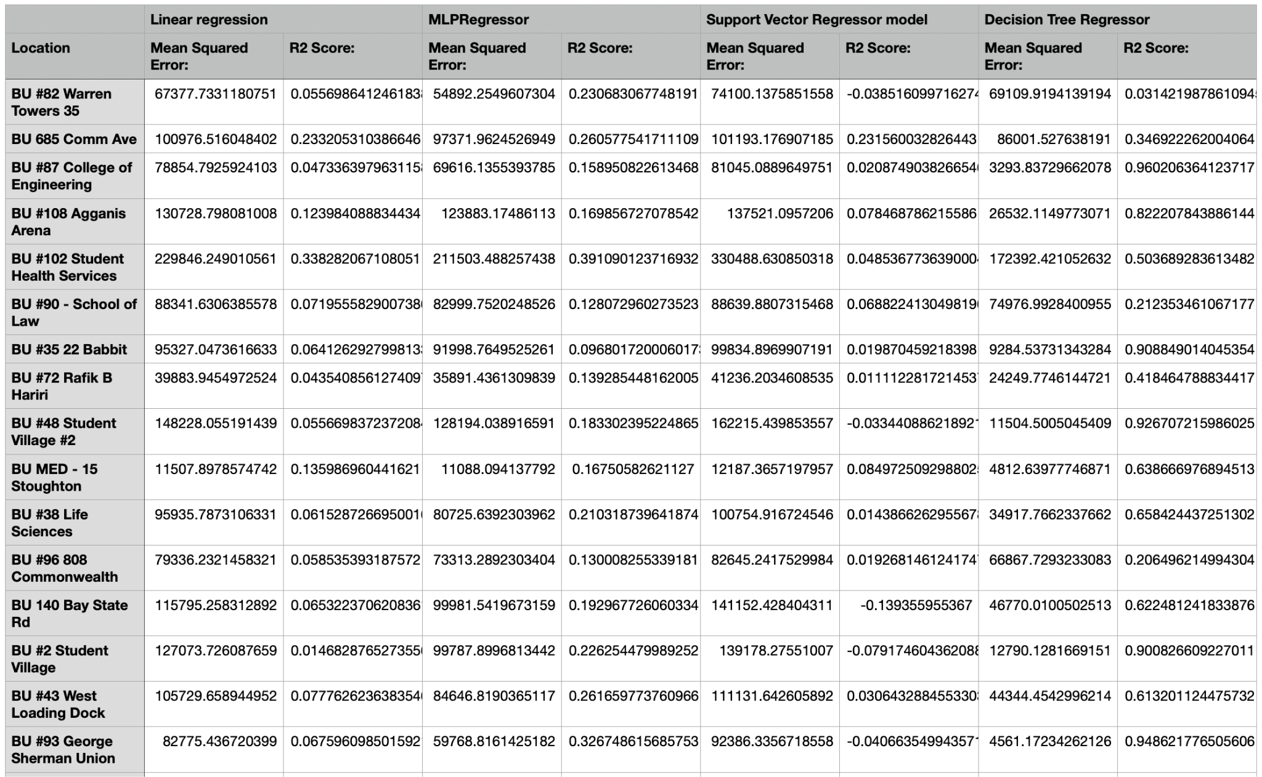
Comparing prediction models
Results of four models:
Linear Regression,
Decision Trees,
Support Vector Machine (SVM)
MLP neural network
models to evaluate their performance and identify any predictive correlation between them.
Data split in training and testing sets using an 80/20 split.

Slide 22
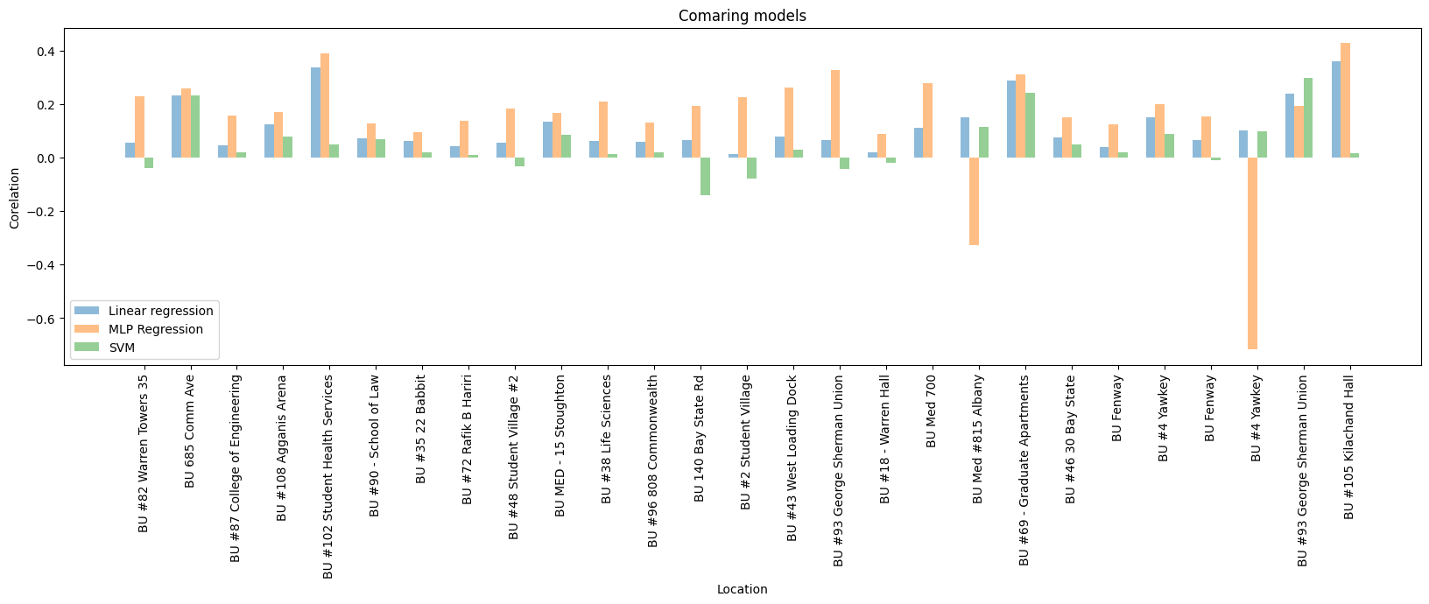
Comparing prediction models

Slide 23
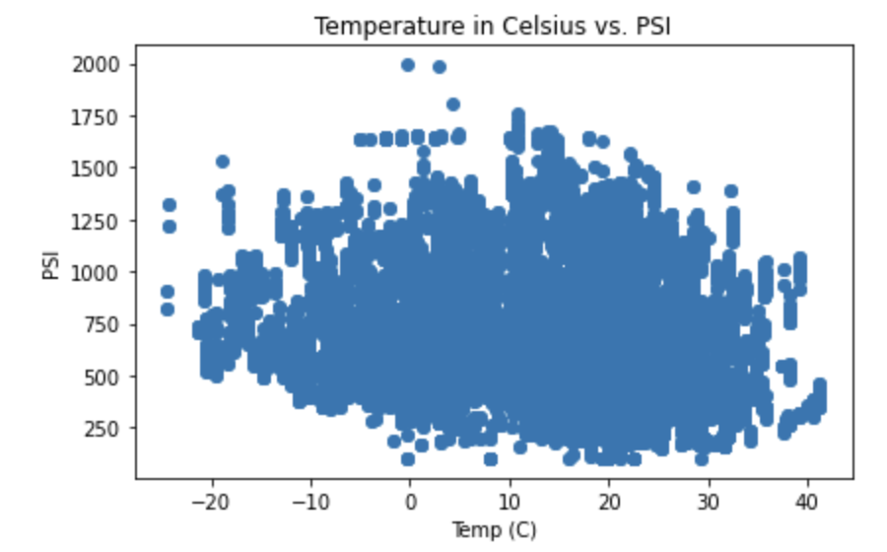
Preprocessing data - Akshad Ramnath
Performed basic cleanup
Identified outliers using z-score > 5 and removed them to further help identify patterns.
Plotted a scatterplot on the filtered data
Notes:
I started off by performing some basic cleanup. Then I identified and removed any outliers with a z-score > 5 from the data using z-score from scipy library. The plot is a scatterplot between temperature in celsius and PSI on the filtered data.

Slide 24
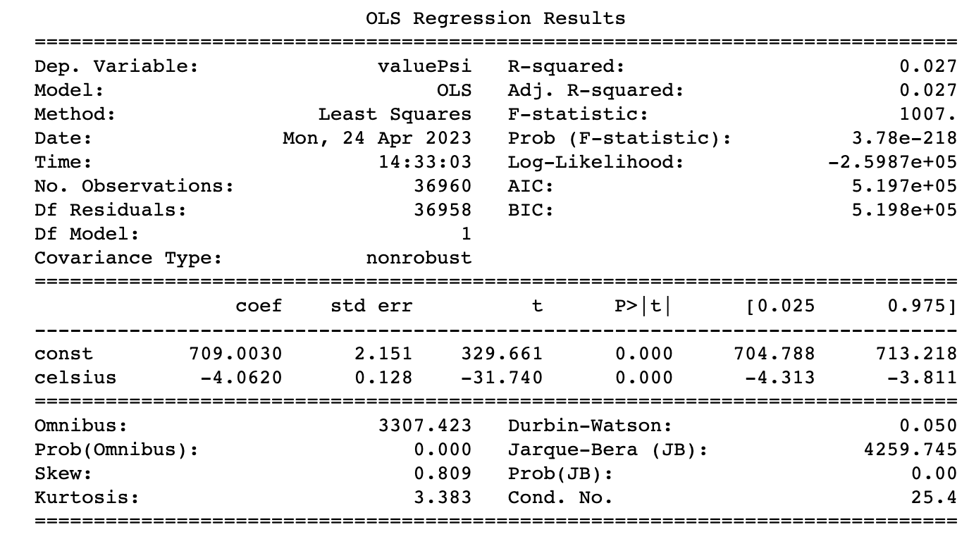
Linear Regression (OLS) - Akshad Ramnath
Performed ordinary least squares on the filtered data
The coefficient value is positive indicating a positive relationship between psi and temperature
Notes:
Performed ordinary least squares on the filtered data using the statsmodels library in Python. The visual represents the results which tells us the strength and direction of the relationship between temperature and PSI values in the data. A key variable to look at is the coefficient value, since it a positive number, it indicates a positive relationship between temperature and PSI.

Slide 25
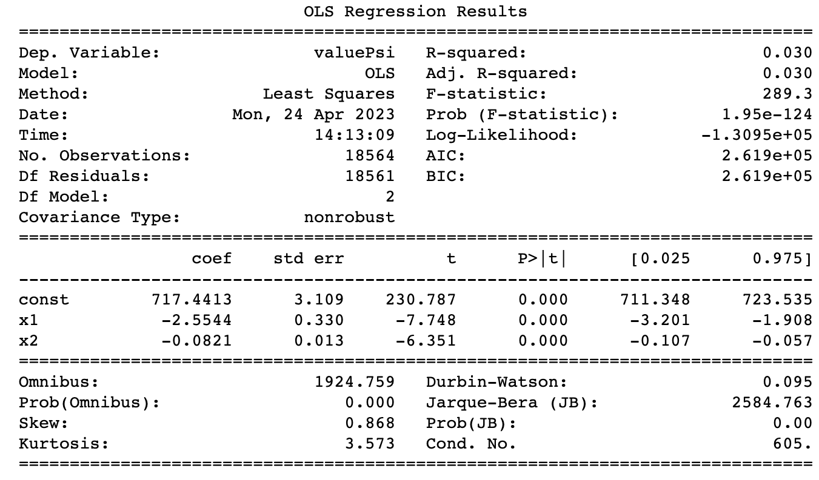
Non-linear Regression - Akshad Ramnath
Performed polynomial regression (see next slide for scatterplot).
The R-squared value is very close to 0 indicating a weak relationship
Notes:
While a simple linear regression assumes a linear relationship between temperature and PSI values, there may be more complex, non-linear relationships at play so i decided to perform polynomial regression. Again, the coefficient is positive. We can also take a look at the R-squared value, which measures the proportion of variation in the dependent variable (PSI) that is explained by the independent variable(s) (temperature). An R-squared value of 1 indicates a perfect fit, while a value of 0 indicates no relationship between the variables. Since the value is closer to 0, it indicates a weak correlation.

Slide 26
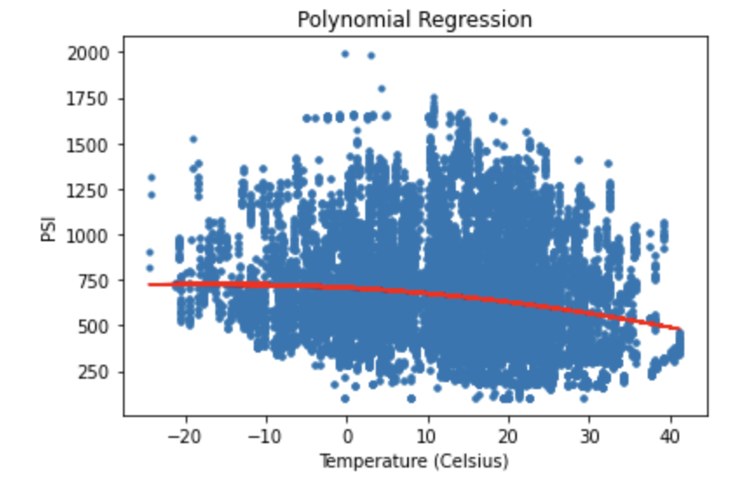
Polynomial Regression - Akshad Ramnath
Notes:
Here we see a plot representation of the results. On performing polynomial regression, the line does indicate a weak relationship between temperature and psi. As you can see the line starts going down the temperature rises indicating that the trash impact is lower in the warmer climates but, this makes logical sense as the warmer climate would indicate summer temperatures when the campus has the least amount of activity.

Slide 27
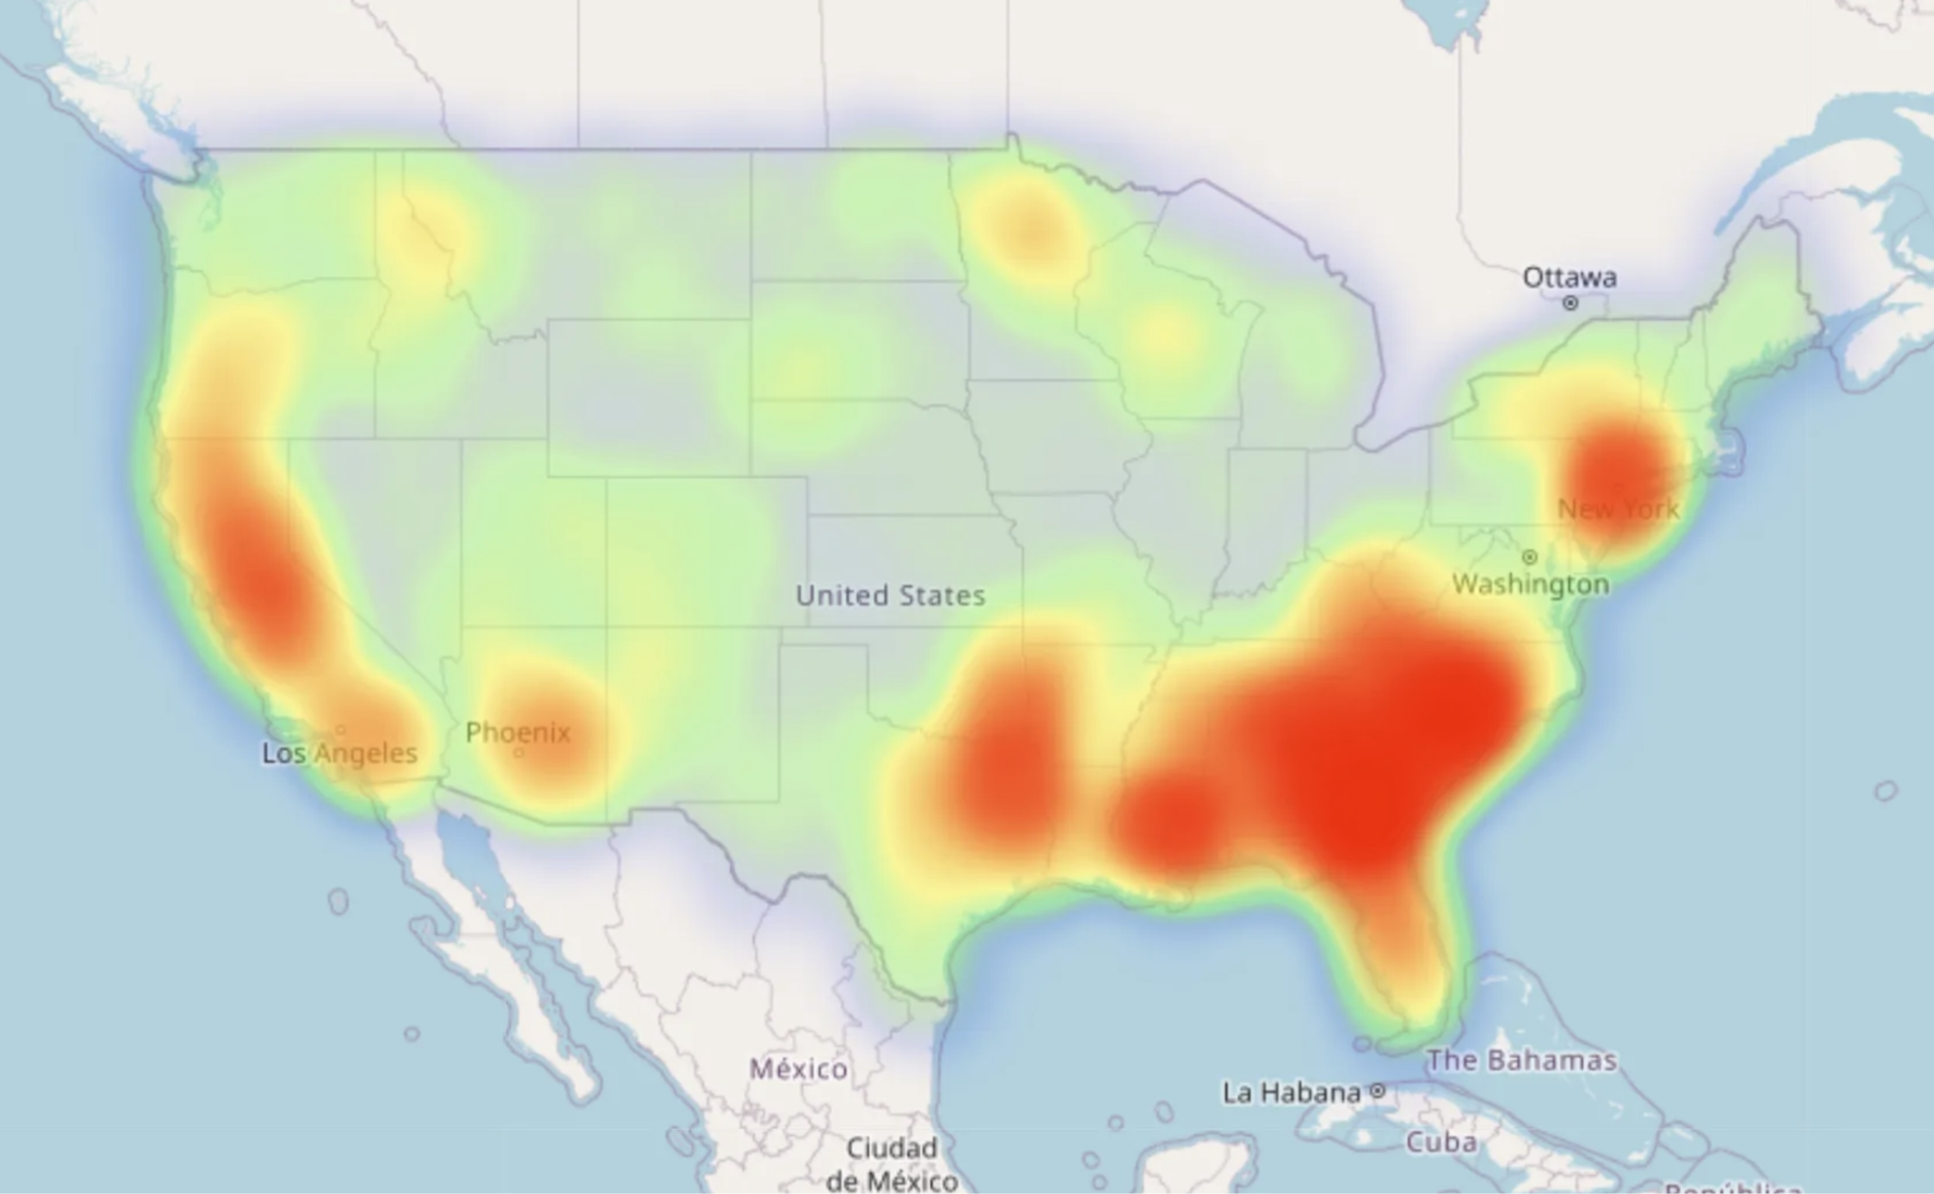
HeatMap Analyzation - Baicheng Fang
The major benefit of heatmap visualization is that it enables data to be presented visually which allows us to easily consume information and make more sense of it.
Color of the graph can quickly give a sense of the density. Where the darker the red, the greater the density.

Slide 28
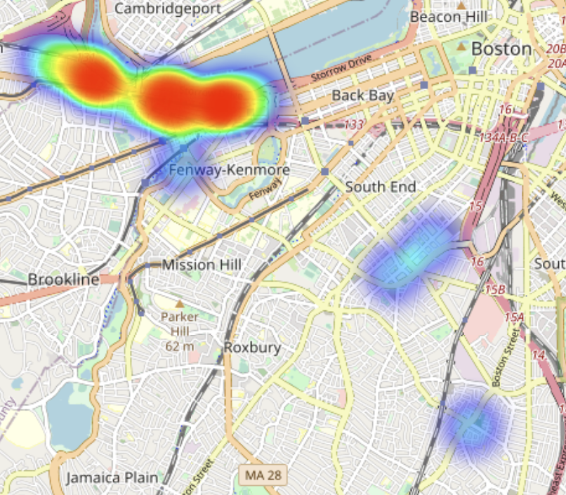
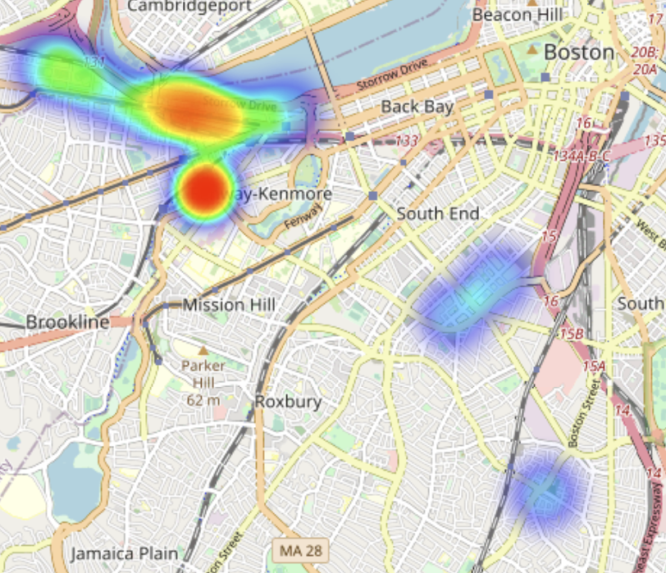
HeatMap Analyzation - Baicheng Fang
HeatMap of Trash
HeatMap of Recycling
Notes:
We can directly tell that in both cases, medical campus produce little waste.

Slide 29
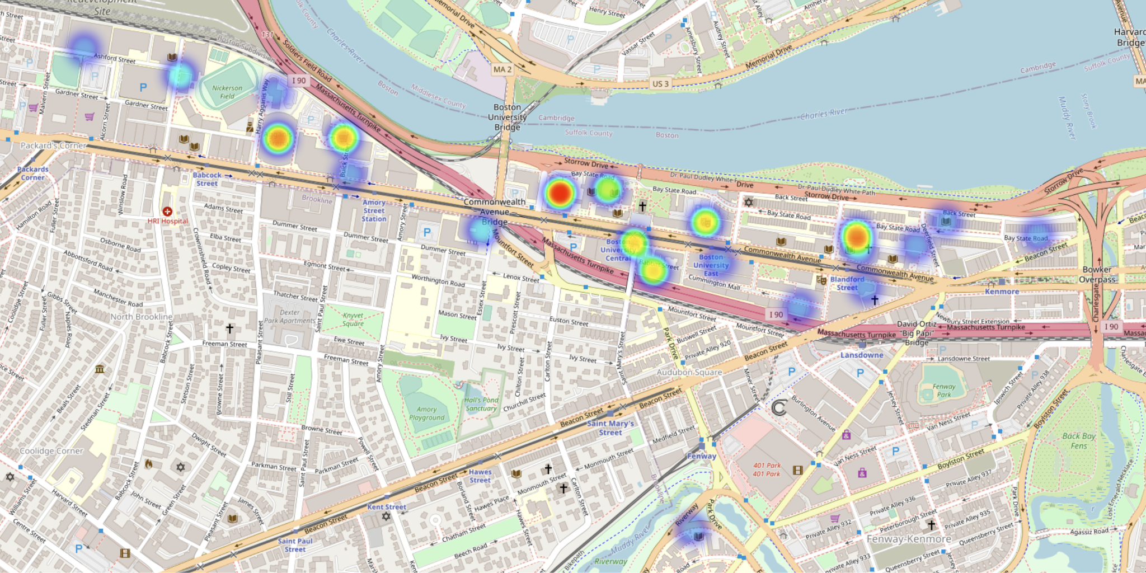
HeatMap Analyzation - Baicheng Fang
Trash on Charles River Campus
From heatmap visualization we can intuitively tell that some sites are the main waste producer like GSU, Towers and Agganis Arena.

Slide 30
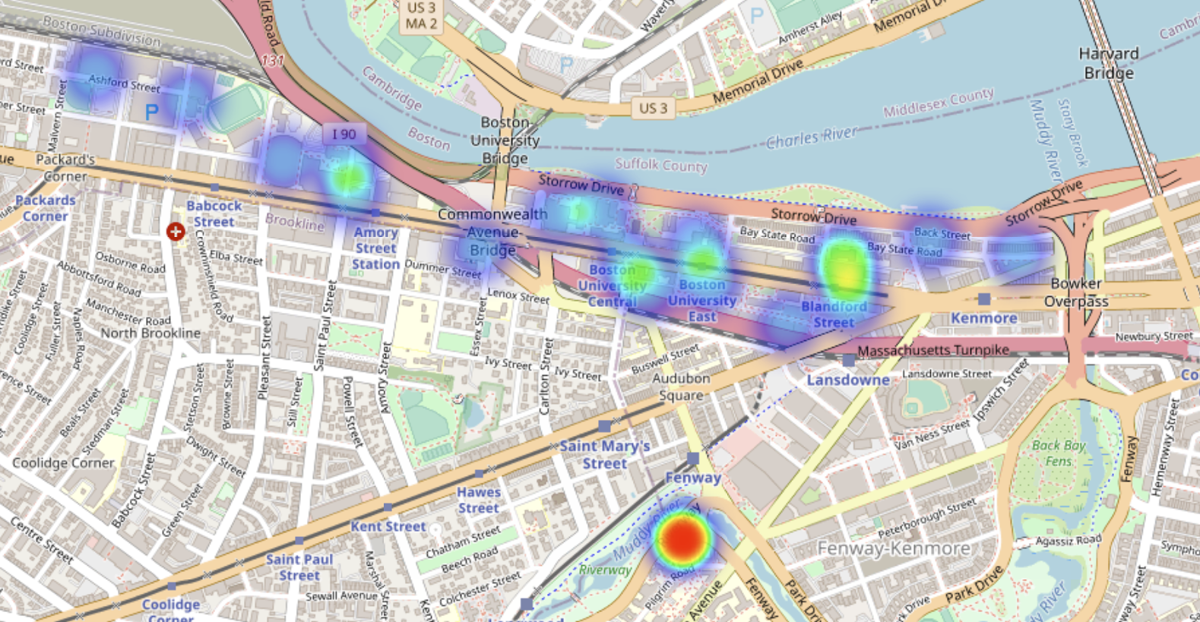
HeatMap Analyzation - Baicheng Fang
Recycling on Charles River Campus
Unlike the situation of trash, it is interesting that Fenway campus is way better at generating recycling.

Slide 31
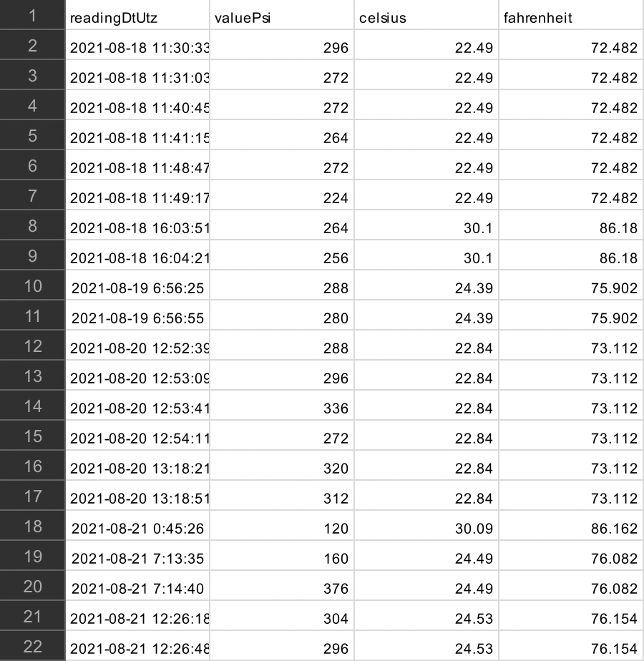
Multi-Linear Analysis - Baicheng Fang
Adding a new Feature—Pressure
Express gratitude to Zeqi for his assiduous work in pre-processing a substantial volume of pressure data and consolidating it according to the corresponding sites. The resulting dataset encompasses average, maximum, and minimum pressure values for each location.

Slide 32
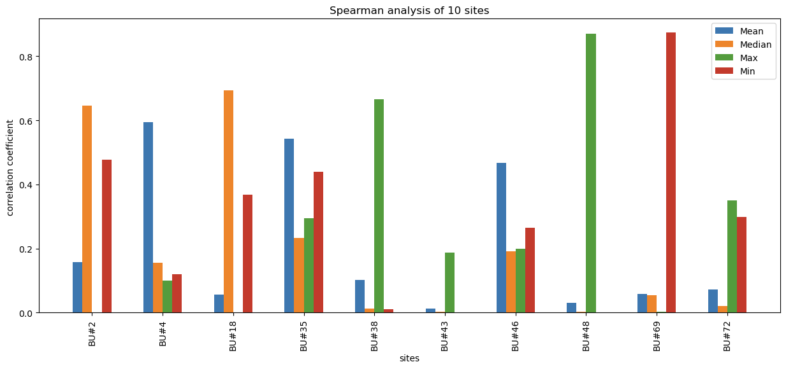
Multi-Linear Analysis - Baicheng Fang
Spearman Correlation Coefficient
Key features of pressure vary across different sites—Fit accordingly

Slide 33
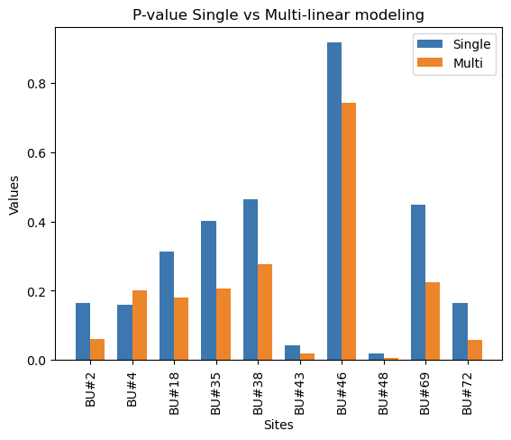
Multi-Linear Analysis - Baicheng Fang
Mse Evaluation
Mean Squared Error (MSE) is a metric to evaluate the performance of regression models
Lower MSE values are indicative of a better model fit, as they suggest that the model's predictions are closer to the actual data points.

Slide 34
Thanks

